Slide 1
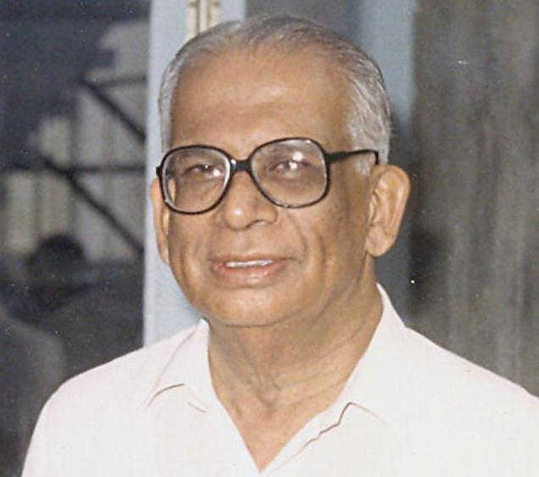
Dr H S BHAT

Slide 3
“Great teachers are not those who dole out facts from a textbook but who pass on their enthusiasm to those assigned to them for training and help them to develop further on their ideas”
Dr Hattangadi Sashidhar Bhat
[21.01.1921 – 19.11.2010]
He insisted that the concept of teacher supremacy
and student subservience is outdated.
2. He was a defender of patients' rights and prerogatives.

Slide 4
UNMATCHED EXCELLENCE: Dr. Bhat enriched every facet of urology with his exceptional skill as a surgeon and absolute commitment as a teacher. November 19 marks the first anniversary of the passing of Professor HattangadiSashidhar Bhat, urologist and teacher.
He was born on January 21, 1921 in Udupi. His father, an accomplished surgeon whose life was defined by advocacy for the poor and respect for human dignity, passed away at the age of 38. His qualities remained in the junior Bhat, and inevitably he chose a career in medicine. After graduating in 1945 from Stanley Medical College, Madras,H.S. Bhat went to Vellore for his M.S. at the Christian Medical College. There he stayed on for three decades as a faculty member.

Slide 5
He was tutored by masters of the surgical craft such as Professors T.H. Sommervel, John Spencer Carmen and Roger Barnes. Of the three, Professor Barnes influenced him most. Having come from the Loma Linda University in California, he was an undisputed master of transurethral resection of the prostate. As a missionary he frequented the CMC and spent months at a stretch teaching and performing surgery. Among the surgical residents, Dr. Barnes reckoned Dr. Bhat, in terms of temperament and talent, to be the most suited to be taught the intricacies of transurethral resection. Dr. Bhat took it all in avidly and gravitated towards urology. From 1957 to 1959, a Rockefeller Fellowship and other fellowships enabled him to work in major American and European centres and interact with urologists such as Fredrik Foley, Leadbetter, Victor Marshal and Reuben Flocks. On his return, he formed the Department of Urology at the CMC Hospital.

Slide 6
In a few years he converted the department into a major centre of urology where he catalysed many a trend-setting event. He was the first Indian surgeon to exploit bladder flaps, intestine, Teflon and penile prosthesis in reconstructive urology. An unmatched resectionist, he oversaw the introduction of the transurethral resection of prostate in India. In fact, he enriched every facet of urology. The pinnacle of these achievements at Vellore was India's first successful renal transplantation in 1971, performed by hisprotégéM. Mohan Rao. As his department's reputation soared, many urologists became interested in watching the master in the art of surgery. Dr. Bhat kept his department open to such young urologists. An M.Ch. course in urology was started in 1965. Many of us junior faculty members of state medical colleges, went to the CMC on study leave to major in urology.

Slide 7
Dr. Bhat aligned himself readily with the changing paradigm and dynamics of postgraduate education. He questioned the relevance of the traditional hierarchical relations between postgraduate teachers and their students, and insisted that the concept of teacher supremacy and student subservience is outdated. He did not see student obsequiousness a substitute for thought and academic perseverance.

Slide 8
Throughout his career, he was a defender of patients' rights and prerogatives. The very work culture of his department was a potent validation of such rights; no surgery was ever performed without a succinct and decipherable explanation of the planned procedure to the patient. And, he insisted that we pay attention to drafting exquisite discharge summaries loaded with strategic details. The summaries were always scrutinised and amended further by Dr. Bhat, who removed verbiage, and added greater reasoning.

Slide 9
There was always an unceasing stream of patients from all social strata to his department. Among them were Rajaji, Periyar, A.K. Gopalan, V.V. Giri, General Thimmayya, E.M.S. Namboodiripad, Jayaprakash Narayan and Amitabh Bachchan. The actor would forever retail Dr. Bhat's services with respect, affection and unalloyed gratitude for restoring his health. Jayaprakash Narayan spent two months at the CMCH during the early part of the Emergency period to undergo a prostate surgery and to subdue his somewhat refractory diabetes.

Slide 10
It is a testament to Dr. Bhat's humility that he never privately or publicly made any claim of having treated such eminent people and remained reticent throughout about his proximity to them. He would bestow identical care to the commoner and the economically disadvantaged as well.

Slide 11
In 1991, Dr. Bhat and his wife Dr.Prema Bhat, a distinguished microbiologist, shifted their establishment to Puttaparthy after having being invited by Sathya Sai Baba to be part of the faculty at the Sri Sathya Sai Institute of Higher Medical Sciences (SSIHMS). They structured their respective departments. He deemed it an opportunity to work in an extraordinary hospital, though largely untested at that point. His former students, now elevated to positions of import at various universities, were more than willing to aid his efforts; they periodically travelled to Puttaparthy to teach and operate. The Department of Urology at the SSIHMS under his stewardship gained national fame in a relatively short period. He conscientiously tended it till his death.

Slide 12
Despite being plagued by health challenges and devastated by the loss of his spouse in 1997, Dr. Bhat's commitment to postgraduate education remained resolute. Even in October 2010, a month before his demise, he found the time and the strength to oversee the conduct of a major postgraduate programme of national salience at the SSIHMS.
(Dr. K. Sasidharan is a former Head of the Department of Urology at Manipal University, a former Editor of the Indian Journal of Urology and Past President of the Urological Society of India. He is now Professor of Urology at the Kerala Institute of Medical Sciences, Thiruvananthapuram.)

Slide 13
COMMENTS
Great people should always be honored, and the writer, by this, has expressed his
gratitude to his guru. The medical profession is a noble profession and those in the medical
Field should ever be at the service of the suffering humanity, whether they are rich or poor.
In the case of the rich, they can afford. But in the case of the poor, the doctor is God in
human form. In the case of DR Bhatt, he was more interested in service and the
development of his specialized branch of medicine. Salutations to a giant in the field.
Permit me to add the names of such service minded giants. DR.MKK MENON of MADRAS,
DR.PKR WARRIOR OF TRIVANDRUM. They while in govt service, were not having
private practice, till retirement.
from: C.P.Chandra Das
Posted on: Nov 19, 2011 at 19:54 IST

Slide 14
I would like to thank Dr.Sashidharan for the article written about Dr.H.S.bhat. He has so beautifully articulated the greatness and personality of such a rare and great soul that HSB was- I am proud to be his daughter.In times when people and Institutions have selective amnesia about the pioneers and teachers who were the pillars of their development and growth, it so touching that such a senior surgeon and Urologist has penned his thoughts of the Guru and Guide and above all a wonderful human being that my father was
from: Thara Francis
Posted on: Nov 19, 2011 at 11:00 IST

Slide 15
I think the age should be 92 not 38 in the article. This kind of mistakes happen, because of difference in numeric keypad in telephones or cell phones and computer key board.
from: sivabala
Posted on: Nov 19, 2011 at 01:24 IST
=======
FROM kscasi WEBSITE: HS Bhat: Father of Indian UrologyRecipient -BC Roy award
Prof H.S. Bhat graduated from StanleyMedical College and obtained hisMS from C.M.C. Vellore. He joined the faculty of C.M.C. in 1953 and served the institution for over three decades.He was responsible for setting up the first department of Urology in thecountry at Vellore.
He was president of Urology society of India. Served on the Editorialboard of Indian J Urology.He was also a member of National Academy of Medical Sciences. Waschairman of a special committee of ICMR.

Slide 16
[21.01.1921 – 19.11.2010]
Born- January 21, 1921 in Udupi
Inherited and imbibed -- advocacy for the poor and respect for human dignity ( from his father –an accomplished surgeon who died at an early age) and chose medicine for a career.
A “Stanleyian” - alumnus of Stanley Medical College, 1945.
Trained for Masters at CMC, Vellore
As Faculty,- trained with pioneers and surgical giants as – Sommerville, JCS Carson, Barnes, Paul Brand
“Spotted” for TURP training in view of his temperament and talent
Awarded the “ Rockefeller Fellowship”- and trained with pioneers ---Foley, Leadbetter, Marshall and, Reuben Flocks. Returned to india with a gifted resectoscope
Established the Urological Service at CMC ,Vellore and pioneered endoscopic surgery in India
Was a bold and innovative surgeon, laid the foundation for the first Successful Renal Transplant in India------ but over the years cautioned against its indiscriminate application in the light of the country’s socio-economic scene.
Trained – the early Urological Surgeons and Teachers from Karnataka---Dr P Venugopal, Dr BT Sampathkumar, Dr AK Annamalai
Enjoyed a tremendous reputation and professional standing drawing patients from all over the country--- including national heads, leaders, politicians, Generals, industrialists, prominent citizens and actors and maintained an equanimity in his modalities of treatment without any discrimination.
Settled in Bangalore after 3 decades of service at CMC
here-- he was “THE SURGEON FOR SURGEONS” ##
Relocated to Puttaparthi in 1991and established the Urological Service at the Sri Sathya Sai Institute of Higher Medical Sciences at Puttaparthi – where he lived and functioned under the direct blessing of Sri Sathya Sai Baba
The Department of Urology at the SSIHMS gained national fame quickly under his guidance. He mentored the service and the Hospital in general till his passing away.

